Slide 1

Bald Hill LUSUKI Outplanting and Seeding 2005-2007
origin
N
Garry Oak/ Poison Oak
woodland
7m
2006 LUSUKI outplant
2006 LUSUKI seeding
10m
T1
T2
2005 LUSUKI seeding
T3
T4
T5
T6
2007 LUSUKI outplant
Scattered poison oak
~100m
Trail
to barn
to ERDE and other LUSUKI site
*Distances and cardinal directions are estimates and not necessarily to scale

Slide 2
Bald Hill LUSUKI 2007-2009, ERDE 2007-2008
N
2007 ERDE outplanting
to Bald Hill summit
Trail
2007 LUSUKI experimental seeding
2008 ERDE outplanting
2008 ERDE outplanting
2007, 2009 LUSUKI seeding plot A 20mx20m
Scattered oaks
2007 ERDE outplanting
2007, 2009 LUSUKI seeding plot B 20mx20m
scattered Rose checkermallow outplanting
2009 LUSUKI experimental seeding
*Distances and cardinal directions are estimates and not necessarily to scale

Slide 3
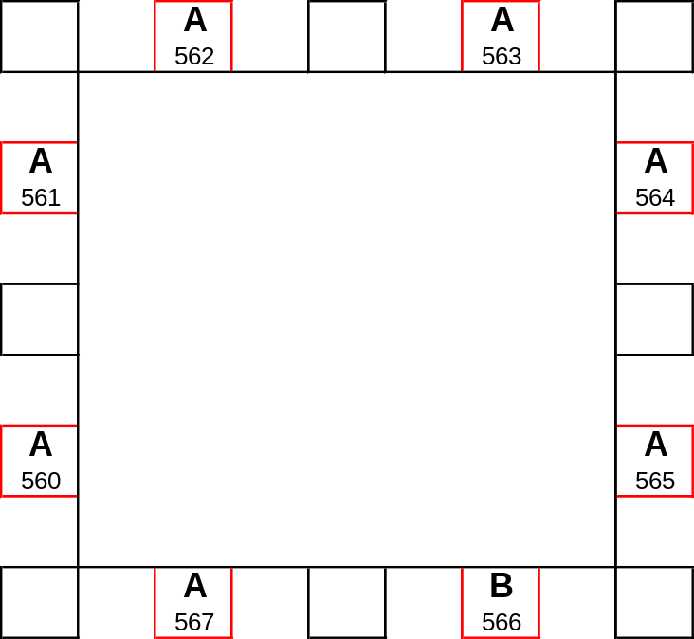
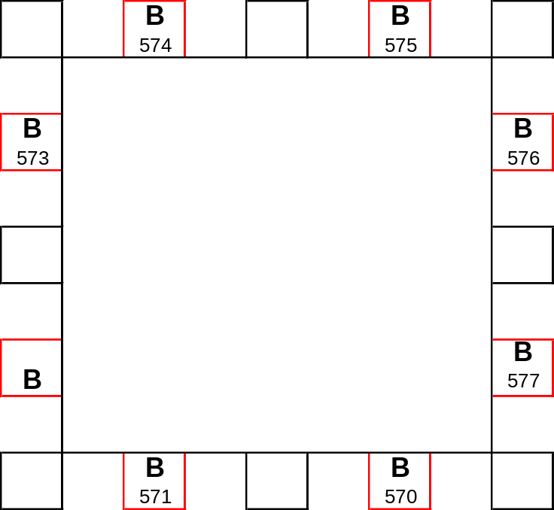
Bald Hill 2009 Seeding Plots- Detail
N
1m
1m
20m
25 Kincaid’s lupine seeds in each 1m² plot
Plot B
(same as LUSUKI 2007 plot A)
1000 A or B seeds in 20m² plot
1m
20m
1m
20m
1000 A or B seeds in 20m² plot
20m
Plot A
(same as 2007 LUSUKI plot A)
2007 experimental LUSUKI plots

Slide 4
Bald Hill LUSUKI outplanting 2009
previous LUSUKI planting
gully
2009 A
scattered oaks
2009 B
Transects 21m long, 2 m apart. Planted every meter beginning at meter one.
N
To seeding plots and previous years’ plantings

Slide 5
Beazell Memorial Forest direct seeding layout Nov. 2006
foot bridge
Mowed meadow
Douglas
Fir
Bird Loop Trail
203° plot 31-40
T1
start
N 44.65553
W123.42817
T2
start
Doug
Fir
Oak
10m plot 21-30
T3
start
2006 LUSUKI seeding
T4
start
LVCS LUSUKI outplanting 2007
downhill
10m plot 11-20
10m plot 1-10
LVCS LUSUKI outplanting 2007
*Distances and cardinal directions are estimates and not necessarily to scale

Slide 6
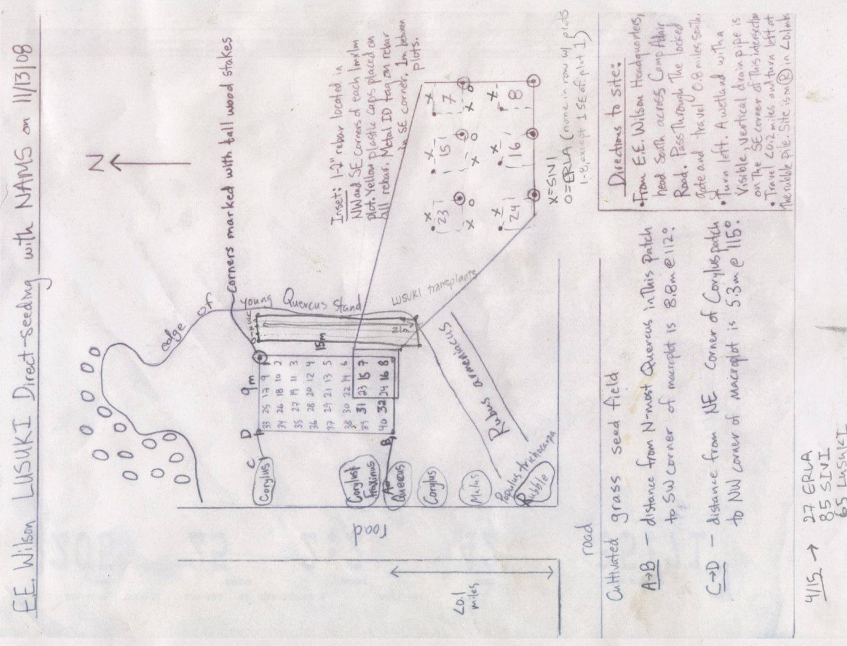

Slide 7
Pond
Finley Wildlife Refuge SINE Outplanting 07-08
2008 SINE outplant – Lincoln School
E
D
C
B
A
T6
T5
T4
N
T3
Small ditch
T2
T1
H
2007 SINE Outplant – Lincoln School
G
F
2008 SINE outplant – Harrisburg HS
Marshy area
Finley bathroom
Parking area
Finley Road
*Distances and cardinal directions are estimates and not necessarily to scale

Slide 8
Finley Wildlife Refuge SINE Outplanting
Turtle Flats May 15, 2009
To Hwy 99
Finley Road
~25 plants each transect
~Planted 1 m apart beginning at meter 1
T0
pond
T2
T4
T6
26 m

Slide 9
Finley Wildlife Refuge LUSUKI Outplanting
Field 29 April 4, 2009
T₃
T₂
Seed Source:
T₀ -- Lupine Meadows or Clarks
T₁ -- 1-13 Lupine Meadows or Clarks, 14- 25 Clarks
T₂ -- 1-8 Clarks, 9-25 Lupine Meadows
T₃ -- Lupine Meadows
T₁
T₀
To entrance
N
25 plants planted 1 meter apart beginning at 1 meter along each 26 m transect. Transects one meter apart.
Finley offices
*Distances and cardinal directions are estimates and not necessarily to scale

Slide 10


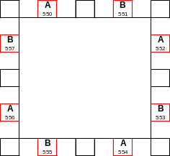
Fitton Green Outplantings and Seedings- 2007-2009
N
2009 LUSUKI seeding plots
2007 LUSUKI outplants
to LUSUKI 2007/09 seeding plot B
2006
LUSUKI
seeding
gully
2009 LUSUKI, SIVI Outplants
gate
LUSUKI 2007/09 seeding plot A
Oak Forest

Slide 11
*Distances and cardinal directions are estimates and not necessarily to scale
Fitton Green LUSUKI 2006/2007-detail
Oak
Poison
oak
Poison
Oak
T1
start
T2
start
T3
start
T4
start
2006 LUSUKI
seeding
(20 plots)
Oak
trail
36m
36m
31m
* Outplantings every meter on the half-meter
0,0
36m
2007 LUSUKI outplant
to LUSUKI 2007 seeding plot B
dirt road
N
2007 LUSUKI direct seeding mass plot A
2007 LUSUKI experimental seeding plots A
Oak forest

Slide 12
Fitton Green 2007-detail
N
2007 LUSUKI direct seeding experimental plots B
to 2007 LUSUKI direct seeding plot A
2007 LUSUKI direct seeding mass plot B
downhill
20m
20m
*Distances and cardinal directions are estimates and not necessarily to scale

Slide 13
Fitton Green LUSUKI and SIVI Outplanting Plots
4.21.09
To gate
To 2007/09 seeding plot B
Planting Plot 09B
Planting Plot 09A
T0
T0
T2
T2
T4
T4
T6
T6
T8
21m
11m

Slide 14
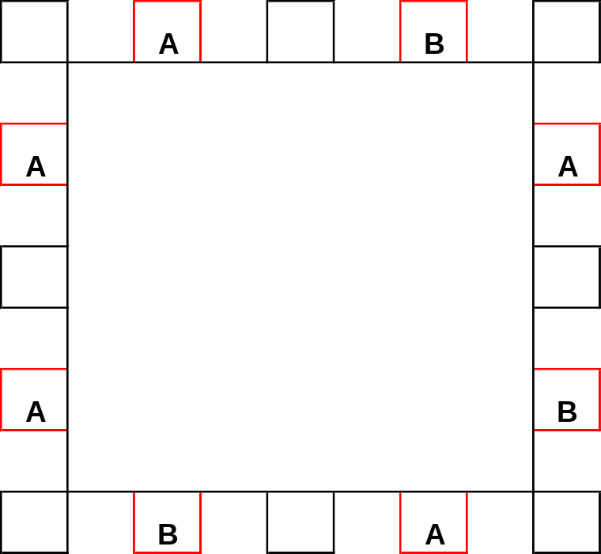
Fitton Green Mass Seeding Plot A-
2009 seeding details
1m
1m
20m
25 Kincaid’s lupine seeds in each 1m² plot
1000 A or B seeds in 20m² plot
20m
uphill

Slide 15
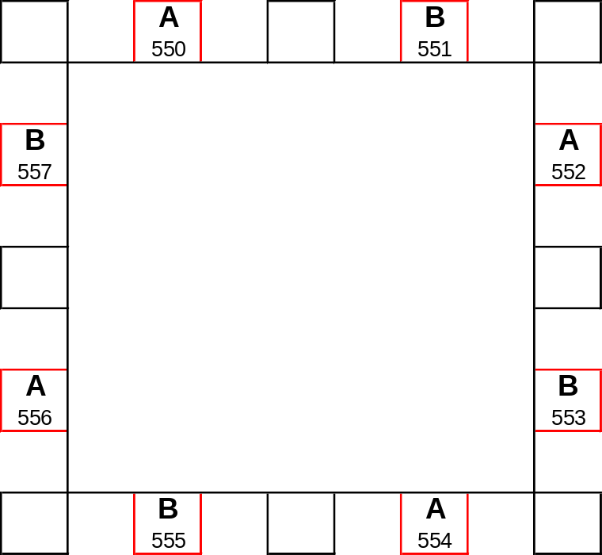
Fitton Green 2009 Mass Seeding Plot B- Detail
1m
1m
20m
25 Kincaid’s lupine seeds in each 1m² plot
uphill
1000 seeds in 20m² plot
20m

Slide 16
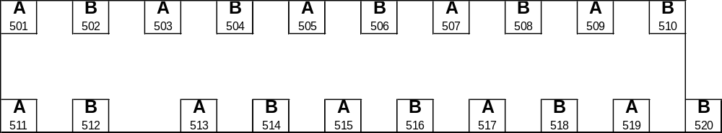
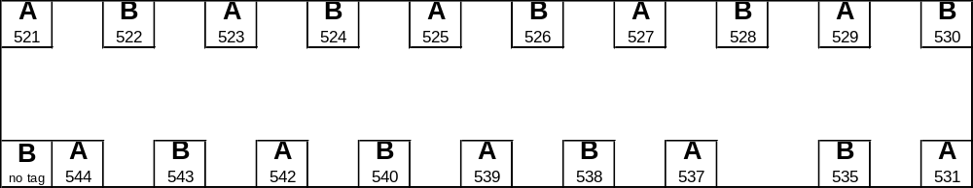
Fitton Green 2009 LUSUKI Seeding Plots- Detail
25 Kincaid’s lupine seeds in each 1x1 meter plot
1m
19m
1m
4m
uphill
Plot 2009-02
1m
19m
1m
4m
536
Plot 2009-01

Slide 17
Rocky outcrop
Lupine Meadows upland outplanting various dates/plots
T7
T6
Jake’s plot (to be removed in 2007)
T5
barn
T4
T3
T2
Wild lusuki
Power
pole
LUSUKI
2006
outplanting
uphill
T1
Parking
LUSUKI
direct seeding
20 plots
Will be removed
Fall 2007
Westhills Road
LUSUKI
Nutrient
plots
17m
N
ERDE
LUSUKI
LUSUKI
ERDE
ERDE
ERDE
uphill
NE Hill
T1
T2
T1
T3
T2
T4
*Distances and cardinal directions are estimates and not necessarily to scale

Slide 18



Lupine Meadows wetland SINE outplanting February 2005
N
Ash forest
Bus parking
Barn
T5
Plot #1
North Patch
T4
drainage
T3
2007 SINE outplanting
19th St.
T2
2007 SINE crop spiral
T1
T1
T2
T3
T4
T5
2006 SINE-PYRA Grid
Plot #2
South Patch
*Distances and cardinal directions are estimates and not necessarily to scale

Slide 19
Jackson-Frazier Wetland – All Sites (not detailed)
Middle Site
Boardwalk Site
99W
boardwalk
N
LOBR direct seeding plots
LOBR 2007 outplanting
to Cheldelin
boardwalk
City East
City West
Lancaster St.
*Distances and cardinal directions are estimates and not necessarily to scale

Slide 20
Jackson-Frazier Wetland – City West
N
26m
planted every meter starting at meter 1
CW5
SINE 2009 outplant
CW6
CW7
CW8
CW1
small creak
CW2
gate
SINE 2007 outplant
CW3
CW4
no stake
wooden fence
26m
22m
SINE 2009
CW 10
CW 9
*Distances and cardinal directions are estimates and not necessarily to scale

Slide 21
Jackson-Frazier Wetland – City East
no stake
CE6
2008 (conetainers, every m)
willow
CE 20091
rebar
CE 2009 2
2007 (every m)
CE4
CE 2009 3
Rebar with write-on tag
CE 2009 4
2007 (every m)
CE3
CE2
2006 (every 3m)
CE5
small creek
2008 (conetainers, every m)
CE 2009 5
N
CE1
2006 (every 3m)
fence
sidewalk
to kiosk and boardwalk
*Distances and cardinal directions are estimates and not necessarily to scale

Slide 22
*Distances and cardinal directions are estimates and not necessarily to scale
N
Jackson-Frazier Wetland – Bradshaw’s lomatium
2007 Bradshaw’s lomatium outplanting
10m
Flowing water in winter
2008 Bradshaw’s lomatium direct seeding plots (25 seeds in each of the 10 m² plots)
2008 LOBR direct seeding plots (25 seeds in each of the 9 m² plots)
existing Bradshaw’s lomatium population
3m
3m
9m
9m
small creek
to parking area
to boardwalk and city east site

Slide 23



*Distances and cardinal directions are estimates and not necessarily to scale
Jackson-Frazier Wetland – Nelson’s checkermallow
Boardwalk Site
B1
ash
N
B3
B2
2007
No stake
2006
2008
B9
No stake
B8
B6
B7
B5
B4
2007 outplant
ash
boardwalk
to parking lot
viewing platform

Slide 24

*Distances and cardinal directions are estimates and not necessarily to scale
Jackson-Frazier Wetland – Middle Site
Nelson’s checkermallow
N
ash
stake missing
2007 Nelson’s checkermallow outplanting
21m
25m
2008 Nelson’s checkermallow outplanting
MF
MG
19m
T1
2006 Nelson’s checkermallow outplanting
MI
MN
stake broken
T2
MH
MJ
MK
ML
MM
ME
MD
MC
MB
MA
2007 SINE outplanting
to gate on the north side of City owned Lancaster West site
wild SINE
Rose thicket

Slide 25
Marys River
Marys River Park
SINE 2009
T0
Six 26m transects spaced 1.5m apart. Plants planted 1m apart beginning at meter one
signage
boardwalk

Slide 26
Owens Farm Restoration Site
Plants every m starting on m 1. Transects 2 m apart. Plot corners marked with rebar and stakes. No plant at transect 6 meter 25.
T₆
T₄
T₂
T₀
2009 SINE outplants
26 m
2009 LOBR transplants and seeding
(see detail next page)
N
2008 SINE outplanting – check transect labels on site
oak
Owens Farm grassfield
F
E
D
C
2007-2008 direct native seeding and camas bulb plots – this is an estimate, check site for exact locations
B
A
creek
*Distances and cardinal directions are estimates and not necessarily to scale

Slide 27
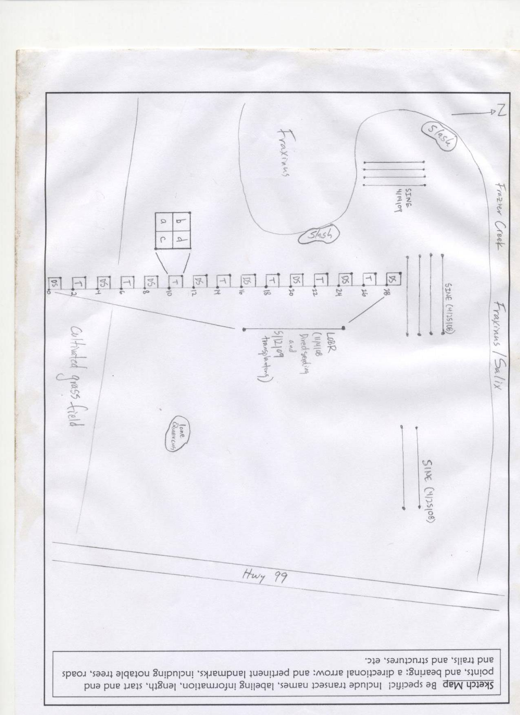
Owens Farm
2008 LOBR direct seeding and 2009 outplanting detail

Slide 28
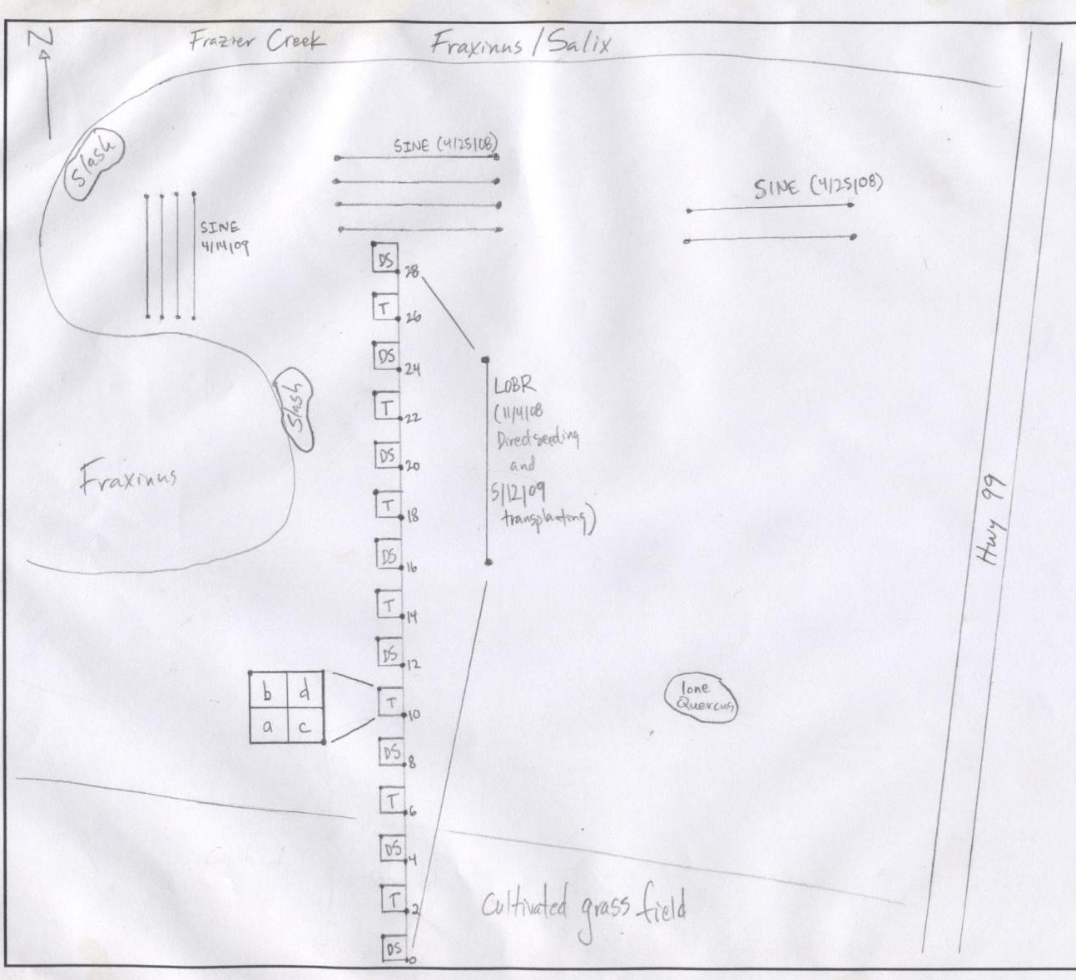
Owens Farm LOBR detail- whole sketch

Slide 29
Philomath Prairie seedings and outplantings
2009
downhill
downhill
60°
2009 LUSUKI direct seeding
(seed detail next page)
Wild LUSUKI
(pin flags)
Plot A
11m
Outplanting transects 1 m apart. Plants every m starting at 1.
T₀
T₁
gully
T₂
60°
Randomly planted LUSUKI
(pin flags)
28m
2009 LUSUKI outplants
Plot B
T₀
T₁
45°
T₂
T₃

Slide 30
Philomath Prairie LUSUKI Direct Seeding- detail
01.29.09
Kincaid’s lupine direct seeding
A seeds and B seeds used
25 seeds in each quarter plot
1000 seeds total
60°
0m
2m
5m
8m
11m
14m
#25
#25
1m
a
b
a
b
a
b
a
b
T₁
2m
#25
S1
d
S2
c
d
S3
c
d
S4
d
S5
#25
c
c
2m
A
B
A
A
A
a
b
a
b
a
b
a
b
a
b
T₂
b
S10
S9
S8
S7
d
S6
d
c
d
c
d
c
d
c
c
A
A
A
B
A

Slide 31
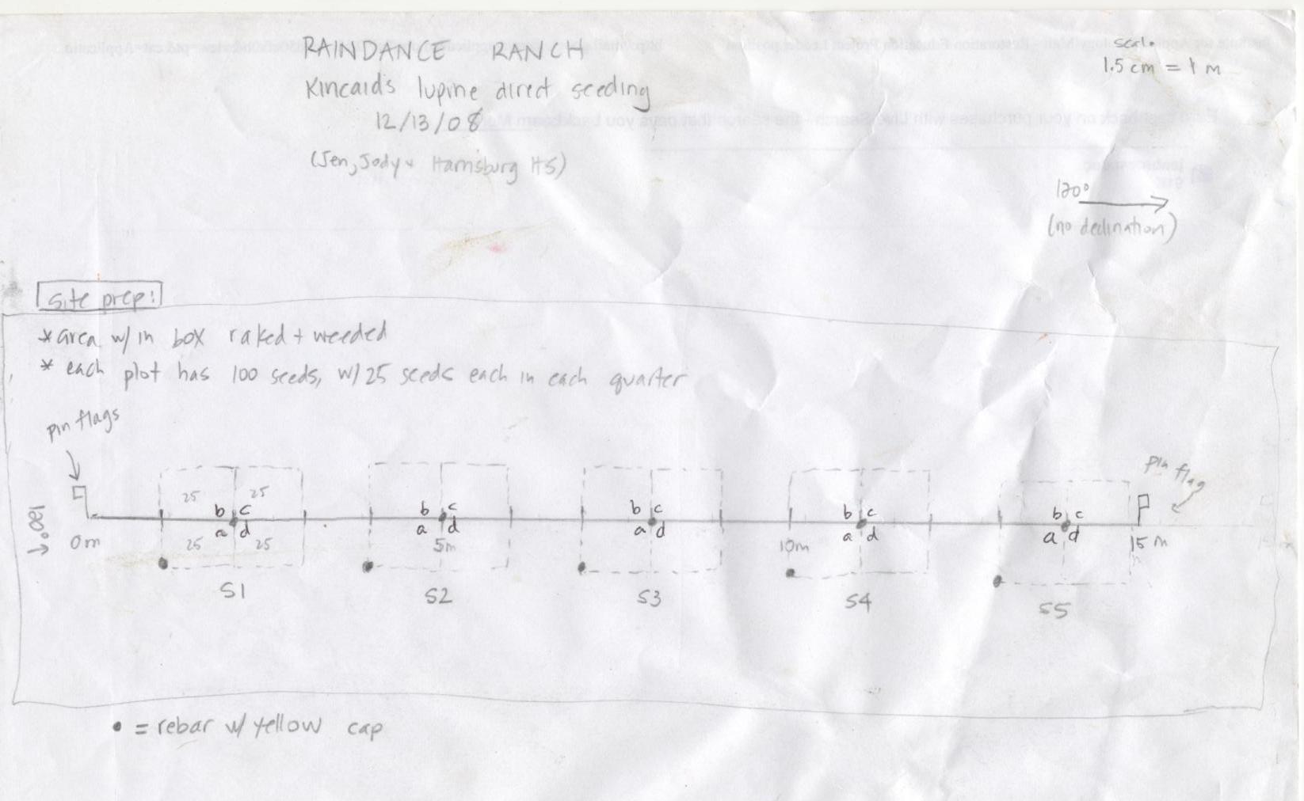
Raindance Ranch LUSUKI seeding 2008

